Slide 1

Lecture 12
ALGORITHMS & DATA STRUCTURES
DEPARTMENT OF COMPUTING
January 21, 2019

Slide 2
Outline
Introduction
Heaps
Implicit heaps

Slide 3
Outline
Introduction
Heaps
Implicit heaps

Slide 4

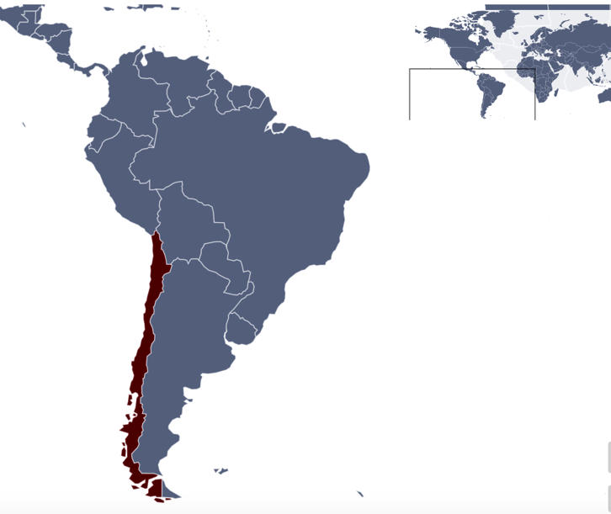



Your new teacher
My name is Alejandra Beghelli Zapata
Born in (crazy) Valparaíso, Chile
VALPARAÍSO

Slide 5




(Valparaíso)

Slide 6

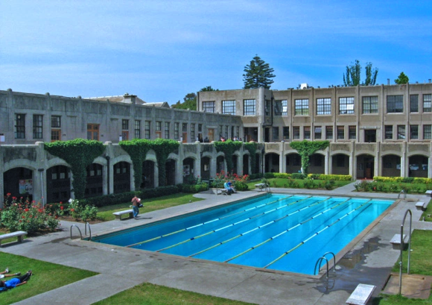
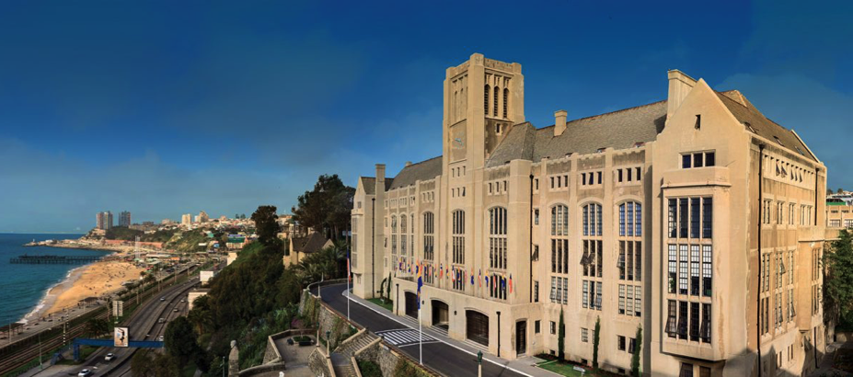
Your new teacher
My name is Alejandra Zapata Beghelli
Born in (crazy) Valparaíso, Chile
Electronic Engineer, Major in Computer Science, Universidad Técnica Federico Santa María, Chile
MSc Electronic Engineering, Major Comp. Science
Universidad Técnica Federico Santa María, Chile
UNIVERSIDAD TÉCNICA FEDERICO SANTA MARÍA

Slide 7

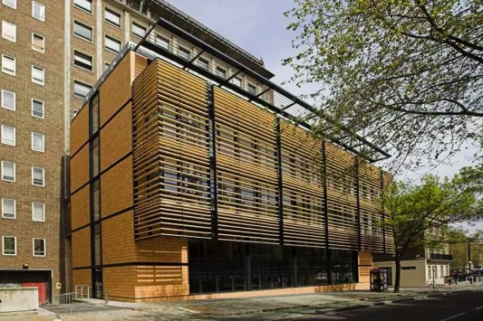

Your new teacher
My name is Alejandra Zapata Beghelli
Born in (crazy) Valparaíso, Chile
Electronic Engineer, Major in Computer Science, Universidad Técnica Federico Santa María, Chile
MSc Electronic Engineering, Major Comp. Sci.
Universidad Técnica Federico Santa María, Chile
PhD in Electronic Engineering, University College London, UK
UNIVERSITY COLLEGE LONDON

Slide 8
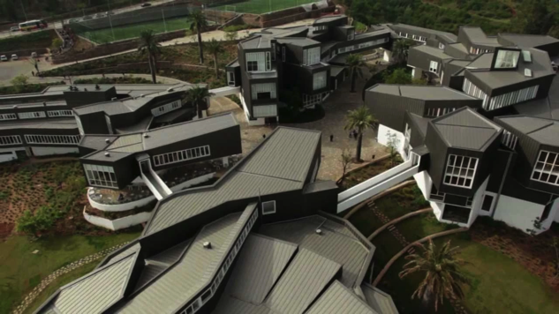
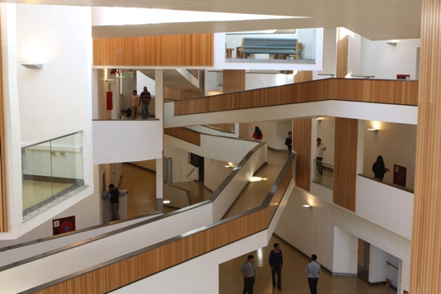

Your new teacher
My name is Alejandra Beghelli Zapata
Born in Valparaíso, Chile
Electronic Engineer, Major in Computer Science, Universidad Técnica Federico Santa María, Chile
MSc Electronic Engineering
Universidad Técnica Federico Santa María, Chile
PhD Electronic Engineering, University College London, UK
I am on a sabbatical leave from Universidad Adolfo Ibañez
UNIVERSIDAD ADOLFO IBAÑEZ

Slide 9
Schedule Term2 (first half)
Mon Tue Wed Thu Fri
Week 11
14-Jan 15-Jan 16-Jan 17-Jan 18-Jan
Lecture 11
Week 12
21-Jan 22-Jan 23-Jan 24-Jan 25-Jan
Lecture 12 Lab.12 Lab.12 Hashing quiz
Lab. Submission Binary Search
Office hours 2-4pm
Week 13
28-Jan 29-Jan 30-Jan 31-Jan 01-Feb
Lecture 13 Lab.13 Lab.13 Binary Search quiz
Office hours 2-4pm
Week 14
04-Feb 05-Feb 06-Feb 07-Feb 08-Feb
Lecture 14 Lab.14 Lab.14 Implicit Data Structures quiz
Lab. Sub.Heap, Heapsort
Office hours 2-4pm
Week 15
11-Feb 12-Feb 13-Feb 14-Feb 15-Feb
Lecture 15 Lab.15 Lab.15 Graphs quiz
Lab. Submission Graphs
ESSAY, Assignment
Office hours 2-4pm
READING WEEK (18-Feb-24Feb)

Slide 10
Schedule Term2 (second half)
Mon Tue Wed Thu Fri
Week 16
25-Feb 26-Feb 27-Feb 28-Feb 01-Mar
Lecture 16 Lab.16 Lab.16 Lab. Submission random numbers
Office hours 2-4pm
Week 17
04-Mar 05-Mar 06-Mar 07-Mar 08-Mar
Lecture 17 Lab.17 Lab.17 Numbers quiz
ESSAY, 1st submission
Office hours 2-4pm
Week 18
11-Mar 12-Mar 13-Mar 14-Mar 15-Mar
Lecture 18 Lab.18 Lab.18 Recursive functions quiz
Lab. Submission Big Integers
ESSAY, Peer assessment
Office hours 2-4pm
Week 19
18-Mar 19-Mar 20-Mar 21-Mar 22-Mar
NO LECTURE Lab.19 Lab.19 Strings quiz
On demand, Skype
Week 20
25-Mar 26-Mar 27-Mar 28-Mar 29-Mar
NO LECTURE Lab.20 Lab.20 General Knowledge quiz
Lab. Submission Lab. Exercise
ESSAY, Final submission
On demand, Skype
END OF TERM

Slide 11
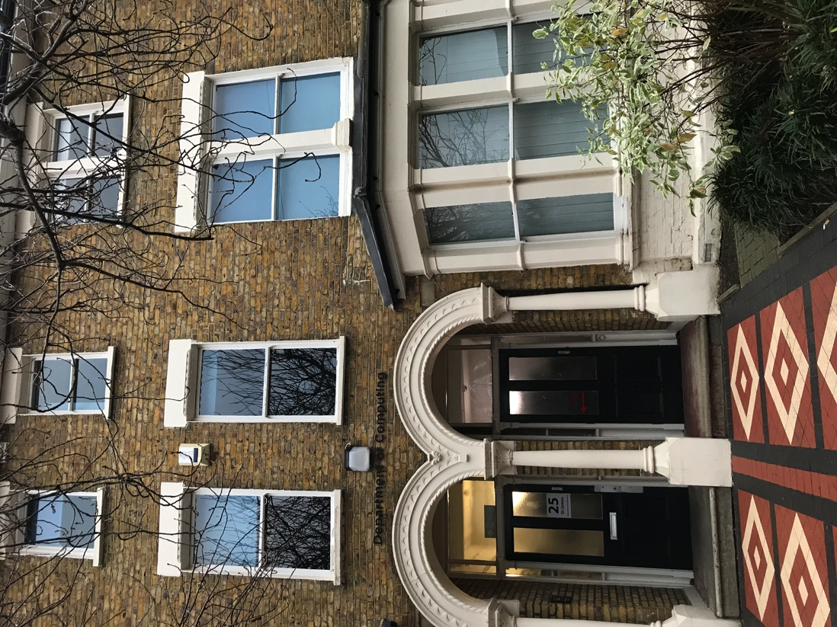
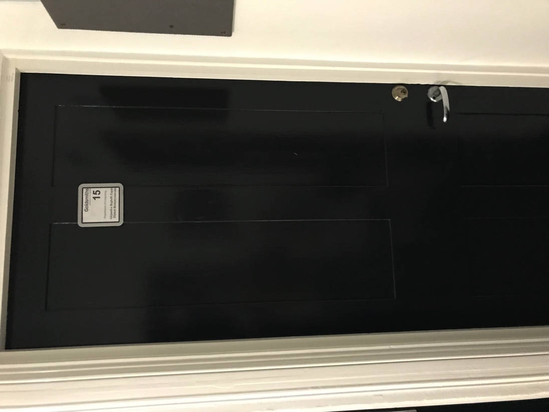
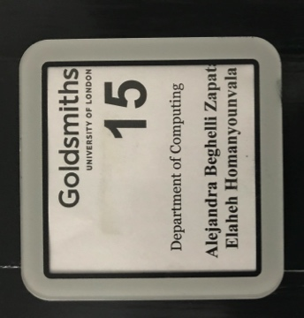
My office
25 ST. JAMES ROAD, ROOM 15

Slide 12
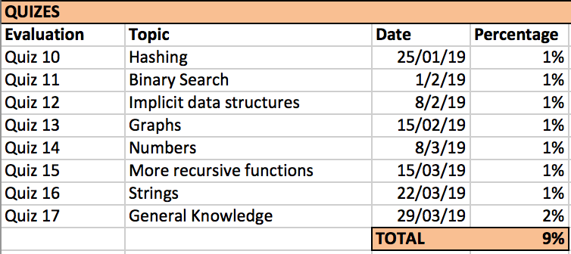
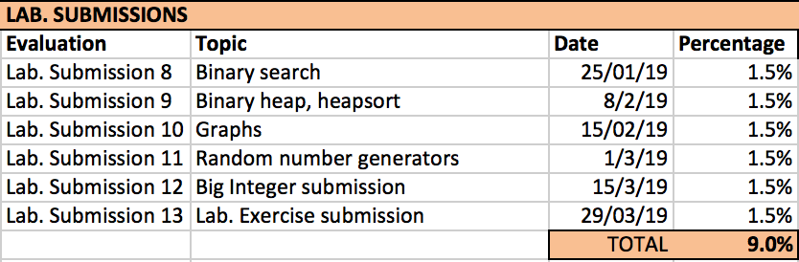
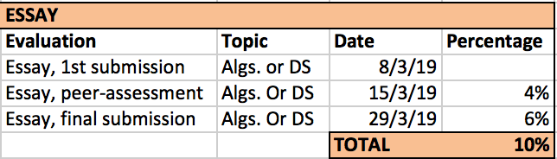
How much is each mark worth?

Slide 13
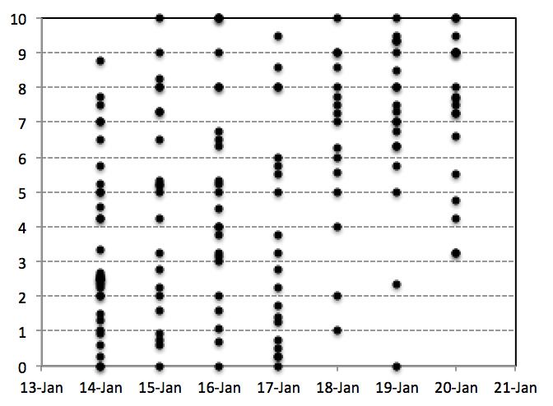
Last Week Summary, Part 0
Hashing quiz so far:
153 attempts (until yesterday 8PM)
8 people have achieved 10 correct answers

Slide 14
Last Week Summary, Part 0
Hashing quiz so far:
153 attempts (until yesterday 8PM)
8 people achieved 10
3
7.1/13
7.5/7
6.7/17
6.9/10
2
2
5.1/30
3
3.5/63
About 80 people haven’t started yet

Slide 15
Last Week Summary, Part I
1) Implicit data structures
In a implicit data structure, the space overhead is constant (irrespective of the number of elements stored in the data structure)
3
8
17
23
-3
23
-3
5
S(N)∈ Θ (N)
This tree representation is NOT an implicit data structure: Space overhead grows linearly with N: S(N)=Nx2xP (P: memory space to store the reference)

Slide 16
Last Week Summary, Part II
2) Multidimensional arrays
Multidimensional arrays are implemented as linear vector(s) (+ metadata).
Row-major ordering
[0] [1] [2] [3] [4]
[0]
[1]
[2]
1 | 2 | 3 | 4 | 5
6 | 7 | 8 | 9 | 10
11 | 12 | 13 | 14 | 15
1 | 2 | 3 | 4 | 5 | 6 | 7 | 8 | 9 | 10 | 11 | 12 | 13 | 14 | 15
row 0
row 1
row 2

Slide 17
Last Week Summary, Part II
2) Multidimensional arrays
Multidimensional arrays are implemented as linear vector(s) (+ metadata).
Row-major ordering
Column-major ordering
[0] [1] [2] [3] [4]
[0] [1] [2] [3] [4]
[0]
[1]
[2]
1 | 2 | 3 | 4 | 5
6 | 7 | 8 | 9 | 10
11 | 12 | 13 | 14 | 15
[0]
[1]
[2]
1 | 2 | 3 | 4 | 5
6 | 7 | 8 | 9 | 10
11 | 12 | 13 | 14 | 15
1 | 2 | 3 | 4 | 5 | 6 | 7 | 8 | 9 | 10 | 11 | 12 | 13 | 14 | 15
row 0
row 1
row 2
1 | 6 | 11 | 2 | 7 | 12 | 3 | 8 | 13 | 4 | 9 | 19 | 5 | 10 | 15
column 0
column 1
column 2
column 3
column 4

Slide 18
Last Week Summary, Part II
Iliffe Vector
[0] [1] [2] [3] [4]
[0]
[1]
[2]
1 | 2 | 3 | 4 | 5
6 | 7 | 8 | 9 | 10
11 | 12 | 13 | 14 | 15
ROW-MAJOR ORDERING
Size of dimension 1 (d1)
3
Size of dim2(d2)
5 | 11 | 12 | 13 | 14 | 15
5 | 6 | 7 | 8 | 9 | 10
5 | 1 | 2 | 3 | 4 | 5
An Iliffe vector is NOT an implicit data structure

Slide 19
Last Week Summary, Part II
Iliffe Vector
[0] [1] [2] [3] [4]
Size of dimension 2 (d2)
COLUMN-MAJOR ORDERING
[0]
[1]
[2]
1 | 2 | 3 | 4 | 5
6 | 7 | 8 | 9 | 10
11 | 12 | 13 | 14 | 15
5
ROW-MAJOR ORDERING
3 | 5 | 10 | 15
Size of dimension 1 (d1)
3 | 4 | 9 | 14
3
Size of dim1 (d1)
3 | 3 | 8 | 13
3 | 2 | 7 | 12
Size of dim2(d2)
5 | 11 | 12 | 13 | 14 | 15
3 | 1 | 6 | 11
5 | 6 | 7 | 8 | 9 | 10
5 | 1 | 2 | 3 | 4 | 5
An Iliffe vector is NOT an implicit data structure

Slide 20
Last Week Summary, Part II
Iliffe Vector (row-major ordering)
Dope Vector (row-major ordering)
[0] [1] [2] [3] [4]
[0] [1] [2] [3] [4]
[0]
[1]
[2]
1 | 2 | 3 | 4 | 5
6 | 7 | 8 | 9 | 10
11 | 12 | 13 | 14 | 15
[0]
[1]
[2]
1 | 2 | 3 | 4 | 5
6 | 7 | 8 | 9 | 10
11 | 12 | 13 | 14 | 15
Dope part
(D+2) elements
Size of dimension 1 (d1)
3
19 | 2 | 3 | 5 | 1 | 2 | 3 | 4 | 5 | 6 | 7 | 8 | 9 | 10 | 11 | 12 | 13 | 14 | 15
Size of dim2(d2)
5 | 11 | 12 | 13 | 14 | 15
Data part
5 | 6 | 7 | 8 | 9 | 10
5 | 1 | 2 | 3 | 4 | 5
An Iliffe vector is NOT an implicit data structure
A Dope vector IS an implicit data structure

Slide 21
Last Week Summary, Part III
3) Binary Search in an implicit data structure
15
10
25
7
12
17
28
7 | 10 | 12 | 15 | 17 | 25 | 28

Slide 22
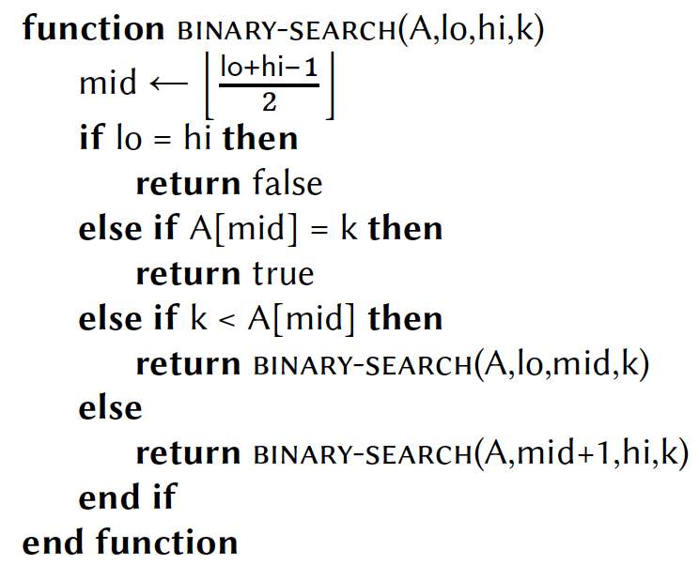
Last Week Summary, Part III
3) Binary Search in an implicit data structure
lo
hi-1
[0] [1] [2] [3] [4] [5] [6]
7 | 10 | 12 | 15 | 17 | 25 | 28
Function BINARY-SEARCH(A,lo,hi,k) returns:
FALSE if value k is not found between [lo,hi-1] in array A (lo < hi)
TRUE if value k is found between [lo,hi-1] in array A
Remember, there is a bug here
(that went undetected for 20 years!).

Slide 23
Last Week Summary, Part III
3) Binary Search in an implicit data structure
lo
hi-1
[0] [1] [2] [3] [4] [5] [6]
7 | 10 | 12 | 15 | 17 | 25 | 28
Function BINARY-SEARCH(A,lo,hi,k) must return:
FALSE if value k is not found between [lo,hi-1] in array A (lo < hi)
TRUE if value k is found between [lo,hi-1] in array A (lo<hi)
Result of BINARY-SEARCH (A,0,7,25)?
TRUE
Result of BINARY-SEARCH (A,4,4,17)?
FALSE
Result of BINARY-SEARCH (A,0,3,15)?
FALSE
Note that in the skeleton of code provided for the lab submission, k is the second argument

Slide 24

How much do you remember?

Slide 25
Outline
Introduction
Heaps (as trees)
Implicit heaps

Slide 26
Heaps as trees
Let’s remember the insert operation (max-heap):
25
Require: heap:: Max-heap
function INSERT!(heap,object)
s <- NEXT (heap)
p <- PARENT(s)
while p ≠ NIL ^p.key< object do
s.key<-p.key
s<-p
p<.PARENT(p)
end while
s.key<-object
end function
10
15
7
12
17
object

Slide 27
Heaps as trees
Let’s remember the insert operation (max-heap):
25
Require: heap:: Max-heap
function INSERT!(heap,object)
s <- NEXT (heap)
p <- PARENT(s)
while p ≠ NIL ^p.key< object do
s.key<-p.key
s<-p
p<.PARENT(p)
end while
s.key<-object
end function
10
15
7
12
s
17
object

Slide 28
Heaps as trees
Let’s remember the insert operation (max-heap):
25
Require: heap:: Max-heap
function INSERT!(heap,object)
s <- NEXT (heap)
p <- PARENT(s)
while p ≠ NIL ^p.key< object do
s.key<-p.key
s<-p
p<.PARENT(p)
end while
s.key<-object
end function
10
15
p
7
12
s
17
object

Slide 29
Heaps as trees
Let’s remember the insert operation (max-heap):
25
Require: heap:: Max-heap
function INSERT!(heap,object)
s <- NEXT (heap)
p <- PARENT(s)
while p ≠ NIL ^p.key< object do
s.key<-p.key
s<-p
p<.PARENT(p)
end while
s.key<-object
end function
10
15
p
7
12
s
17
object

Slide 30
Heaps as trees
Let’s remember the insert operation (max-heap):
25
Require: heap:: Max-heap
function INSERT!(heap,object)
s <- NEXT (heap)
p <- PARENT(s)
while p ≠ NIL ^p.key< object do
s.key<-p.key
s<-p
p<.PARENT(p)
end while
s.key<-object
end function
10
15
p
7
12
15
s
17
object

Slide 31
Heaps as trees
Let’s remember the insert operation (max-heap):
25
Require: heap:: Max-heap
function INSERT!(heap,object)
s <- NEXT (heap)
p <- PARENT(s)
while p ≠ NIL ^p.key< object do
s.key<-p.key
s<-p
p<.PARENT(p)
end while
s.key<-object
end function
10
15
p
s
7
12
15
17
object

Slide 32
Heaps as trees
Let’s remember the insert operation (max-heap):
25
p
Require: heap:: Max-heap
function INSERT!(heap,object)
s <- NEXT (heap)
p <- PARENT(s)
while p ≠ NIL ^p.key< object do
s.key<-p.key
s<-p
p<-PARENT(p)
end while
s.key<-object
end function
10
15
s
7
12
15
17
object

Slide 33
Heaps as trees
Let’s remember the insert operation (max-heap):
25
p
Require: heap:: Max-heap
function INSERT!(heap,object)
s <- NEXT (heap)
p <- PARENT(s)
while p ≠ NIL ^p.key< object do
s.key<-p.key
s<-p
p<-PARENT(p)
end while
s.key<-object
end function
10
15
s
7
12
15
17
object

Slide 34
Heaps as trees
Let’s remember the insert operation (max-heap):
25
p
Require: heap:: Max-heap
function INSERT!(heap,object)
s <- NEXT (heap)
p <- PARENT(s)
while p ≠ NIL ^p.key< object do
s.key<-p.key
s<-p
p<-PARENT(p)
end while
s.key<-object
end function
10
15
s
7
12
15
17
object

Slide 35
Heaps as trees
Let’s remember the insert operation (max-heap):
25
p
Require: heap:: Max-heap
function INSERT!(heap,object)
s <- NEXT (heap)
p <- PARENT(s)
while p ≠ NIL ^p.key< object do
s.key<-p.key
s<-p
p<-PARENT(p)
end while
s.key<-object
end function
10
17
s
7
12
15

Slide 36
Heaps as a trees
Let’s remember the insert operation (max-heap):
25
p
Require: heap:: Max-heap
function INSERT!(heap,object)
s <- NEXT (heap)
p <- PARENT(s)
while p ≠ NIL ^p.key< object do
s.key<-p.key
s<-p
p<-PARENT(p)
end while
s.key<-object
end function
10
17
s
7
12
15
INSERT! is Θ(log N)

Slide 37
Constructing a (max-)heap from scratch
Require: S:: array with elements to add
function MAKE-HEAP(S)
H <- new Heap()
for 0 ≤ i < length(S) do
INSERT!(H,S[i])
end for
end function

Slide 38
Constructing a (max-)heap from scratch
[0] [1] [2] [3] [4] [5]
3 | 14 | 6 | 89 | 21 | 9
Require: S:: array with elements to add
function MAKE-HEAP(S)
H <- new Heap()
for 0 ≤ i < length(S) do
INSERT!(H,S[i])
end for
end function

Slide 39
Constructing a (max-)heap from scratch
[0] [1] [2] [3] [4] [5]
3 | 14 | 6 | 89 | 21 | 9
H
NIL
Require: S:: array with elements to add
function MAKE-HEAP(S)
H <- new Heap()
for 0 ≤ i < length(S) do
INSERT!(H,S[i])
end for
end function

Slide 40
Constructing a (max-)heap from scratch
[0] [1] [2] [3] [4] [5]
3 | 14 | 6 | 89 | 21 | 9
H
NIL
Require: S:: array with elements to add
function MAKE-HEAP(S)
H <- new Heap()
for 0 ≤ i < length(S) do
INSERT!(H,S[i])
end for
end function
i<-0

Slide 41
Constructing a (max-)heap from scratch
[0] [1] [2] [3] [4] [5]
3 | 14 | 6 | 89 | 21 | 9
H
NIL
Require: S:: array with elements to add
function MAKE-HEAP(S)
H <- new Heap()
for 0 ≤ i < length(S) do
INSERT!(H,S[i])
end for
end function
i<-0

Slide 42
Constructing a (max-)heap from scratch
H
3
H
NIL
Require: heap:: Max-heap
function INSERT!(heap,object)
s <- NEXT (heap)
p <- PARENT(s)
while p ≠ NIL ^p.key< object do
s.key<-p.key
s<-p
p<-PARENT(p)
end while
s.key<-object
end function
3 object

Slide 43
Constructing a (max-)heap from scratch
H
3
H
Require: heap:: Max-heap
function INSERT!(heap,object)
s <- NEXT (heap)
p <- PARENT(s)
while p ≠ NIL ^p.key< object do
s.key<-p.key
s<-p
p<-PARENT(p)
end while
s.key<-object
end function
s
3 object

Slide 44
Constructing a (max-)heap from scratch
H
3
H
NIL
p
Require: heap:: Max-heap
function INSERT!(heap,object)
s <- NEXT (heap)
p <- PARENT(s)
while p ≠ NIL ^p.key< object do
s.key<-p.key
s<-p
p<-PARENT(p)
end while
s.key<-object
end function
s
3 object

Slide 45
Constructing a (max-)heap from scratch
H
3
H
NIL
p
Require: heap:: Max-heap
function INSERT!(heap,object)
s <- NEXT (heap)
p <- PARENT(s)
while p ≠ NIL ^p.key< object do
s.key<-p.key
s<-p
p<-PARENT(p)
end while
s.key<-object
end function
s
3 object

Slide 46
Constructing a (max-)heap from scratch
H
3
H
NIL
p
Require: heap:: Max-heap
function INSERT!(heap,object)
s <- NEXT (heap)
p <- PARENT(s)
while p ≠ NIL ^p.key< object do
s.key<-p.key
s<-p
p<-PARENT(p)
end while
s.key<-object
end function
3
s
3 object

Slide 47
Constructing a (max-)heap from scratch
H
3
H
NIL
p
Require: heap:: Max-heap
function INSERT!(heap,object)
s <- NEXT (heap)
p <- PARENT(s)
while p ≠ NIL ^p.key< object do
s.key<-p.key
s<-p
p<-PARENT(p)
end while
s.key<-object
end function
3
s

Slide 48
Constructing a (max-)heap from scratch
[0] [1] [2] [3] [4] [5]
H
3 | 14 | 6 | 89 | 21 | 9
Require: S:: array with elements to add
function MAKE-HEAP(S)
H <- new Heap()
for 0 ≤ i < length(S) do
INSERT!(H,S[i])
end for
end function
3
i<-1

Slide 49
Constructing a (max-)heap from scratch
[0] [1] [2] [3] [4] [5]
H
3 | 14 | 6 | 89 | 21 | 9
Require: S:: array with elements to add
function MAKE-HEAP(S)
H <- new Heap()
for 0 ≤ i < length(S) do
INSERT!(H,S[i])
end for
end function
3
i<-1

Slide 50
Constructing a (max-)heap from scratch
H
H
14
3
Require: heap:: Max-heap
function INSERT!(heap,object)
s <- NEXT (heap)
p <- PARENT(s)
while p ≠ NIL ^p.key< object do
s.key<-p.key
s<-p
p<-PARENT(p)
end while
s.key<-object
end function
14 object

Slide 51
Constructing a (max-)heap from scratch
H
H
14
3
Require: heap:: Max-heap
function INSERT!(heap,object)
s <- NEXT (heap)
p <- PARENT(s)
while p ≠ NIL ^p.key< object do
s.key<-p.key
s<-p
p<-PARENT(p)
end while
s.key<-object
end function
s
14 object

Slide 52
Constructing a (max-)heap from scratch
H
H
14
p
3
Require: heap:: Max-heap
function INSERT!(heap,object)
s <- NEXT (heap)
p <- PARENT(s)
while p ≠ NIL ^p.key< object do
s.key<-p.key
s<-p
p<-PARENT(p)
end while
s.key<-object
end function
s
14 object

Slide 53
Constructing a (max-)heap from scratch
H
H
14
p
3
Require: heap:: Max-heap
function INSERT!(heap,object)
s <- NEXT (heap)
p <- PARENT(s)
while p ≠ NIL ^p.key< object do
s.key<-p.key
s<-p
p<-PARENT(p)
end while
s.key<-object
end function
s
14 object

Slide 54
Constructing a (max-)heap from scratch
H
H
14
p
3
Require: heap:: Max-heap
function INSERT!(heap,object)
s <- NEXT (heap)
p <- PARENT(s)
while p ≠ NIL ^p.key< object do
s.key<-p.key
s<-p
p<-PARENT(p)
end while
s.key<-object
end function
s
3
14 object

Slide 55
Constructing a (max-)heap from scratch
H
H
14
p
3
Require: heap:: Max-heap
function INSERT!(heap,object)
s <- NEXT (heap)
p <- PARENT(s)
while p ≠ NIL ^p.key< object do
s.key<-p.key
s<-p
p<-PARENT(p)
end while
s.key<-object
end function
s
3
14 object

Slide 56
Constructing a (max-)heap from scratch
H
H
14
p
NIL
s
3
Require: heap:: Max-heap
function INSERT!(heap,object)
s <- NEXT (heap)
p <- PARENT(s)
while p ≠ NIL ^p.key< object do
s.key<-p.key
s<-p
p<-PARENT(p)
end while
s.key<-object
end function
3
14 object

Slide 57
Constructing a (max-)heap from scratch
H
H
14
p
NIL
s
3
Require: heap:: Max-heap
function INSERT!(heap,object)
s <- NEXT (heap)
p <- PARENT(s)
while p ≠ NIL ^p.key< object do
s.key<-p.key
s<-p
p<-PARENT(p)
end while
s.key<-object
end function
3
14 object

Slide 58
Constructing a (max-)heap from scratch
H
H
14
p
NIL
s
3
Require: heap:: Max-heap
function INSERT!(heap,object)
s <- NEXT (heap)
p <- PARENT(s)
while p ≠ NIL ^p.key< object do
s.key<-p.key
s<-p
p<-PARENT(p)
end while
s.key<-object
end function
3
14 object

Slide 59
Constructing a (max-)heap from scratch
H
H
14
p
NIL
s
14
Require: heap:: Max-heap
function INSERT!(heap,object)
s <- NEXT (heap)
p <- PARENT(s)
while p ≠ NIL ^p.key< object do
s.key<-p.key
s<-p
p<-PARENT(p)
end while
s.key<-object
end function
3
14 object

Slide 60
Constructing a (max-)heap from scratch
[0] [1] [2] [3] [4] [5]
3 | 14 | 6 | 89 | 21 | 9
14
Require: S:: array with elements to add
function MAKE-HEAP(S)
H <- new Heap()
for 0 ≤ i < length(S) do
INSERT!(H,S[i])
end for
end function
i<-2
3
Etc…

Slide 61
Constructing a (max-)heap from scratch
[0] [1] [2] [3] [4] [5]
3 | 14 | 6 | 89 | 21 | 9
89
Require: S:: array with elements to add
function MAKE-HEAP(S)
H <- new Heap()
for 0 ≤ i < length(S) do
INSERT!(H,S[i])
end for
end function
21
9
3
14
6
Complexity: O(NlogN)

Slide 62
So far, heap as an explicit data structure
89
89
21
9
21
9
3
14
3
14

Slide 63
Outline
Introduction
Heaps (as trees)
Implicit heaps

Slide 64
Heap as an implicit data structure
[0]
89
[1]
[2]
21
9
[3]
[4]
[5]
[6]
3
14
4
7
[0] [1] [2] [3] [4] [5] [6]
89 | 21 | 9 | 3 | 14 | 4 | 7

Slide 65
Heap as an implicit data structure
[0]
89
NODE | PARENT | LEFT CHILD | RIGHT CHILD
[0] | --- | [1] | [2]
[1] | [0] | [3] | [4]
[2] | [0] | [5] | [6]
[3] | [1] | [7] | [8]
[4] | [1] | [9] | [10]
[5] | [2] | [11] | [12]
[6] | [2] | [13] | [14]
[1]
[2]
51
69
[3]
[4]
[5]
[6]
43
34
54
67
[0] [1] [2] [3] [4] [5] [6]
89 | 21 | 9 | 3 | 14 | 4 | 7

Slide 66
Heap as an implicit data structure
Let’s find the pattern here…
NODE | PARENT | LEFT CHILD | RIGHT CHILD
[0] | --- | [1] | [2]
[1] | [0] | [3] | [4]
[2] | [0] | [5] | [6]
[3] | [1] | [7] | [8]
[4] | [1] | [9] | [10]
[5] | [2] | [11] | [12]
[6] | [2] | [13] | [14]
[7] | [3] | [15] | [16]
… | … | … | …
[k] | ? | ? | ?

Slide 67
Heap as an implicit data structure
Let’s find the pattern here…
NODE | PARENT | LEFT CHILD | RIGHT CHILD
[0] | --- | [1] | [2]
[1] | [0] | [3] | [4]
[2] | [0] | [5] | [6]
[3] | [1] | [7] | [8]
[4] | [1] | [9] | [10]
[5] | [2] | [11] | [12]
[6] | [2] | [13] | [14]
[7] | [3] | [15] | [16]
… | … | … | …
[k] | FLOOR[(k-1)/2] | 2×k+1 | 2×k+2

Slide 68
First set of functions in implicit heap
function PARENT(k)
return FLOOR((k-1)/2)
end function
function LEFT(k)
return 2×k+1
end function
function RIGHT(k)
return 2×k+2
end function
These functions allow us to move through the implicit heap

Slide 69
Implicit heap operations
INSERT! (insert one element to the heap)
EXTRACT_MAX! (extract maximum value from heap)
BUILD-MAX-HEAP (build a heap in place)

Slide 70
Implicit heap operations
INSERT! (insert one element to the heap)
EXTRACT_MAX! (extract maximum value from heap)
BUILD-MAX-HEAP (build a heap in place)

Slide 71
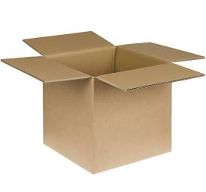
Inserting elements in the implicit (max) heap
heap.size
heap
0
[0] [1] [2] [3] [4]
23 | 17 | 19 | 12
k
54

Slide 72
Inserting elements in the implicit (max) heap
function INSERT!(heap,k)
pos<-heap.size
heap[pos]<- k
heap.size<-heap.size+1
while(pos >0 ^ heap[parent(pos)]<heap[pos])
SWAP(heap[parent(pos)], heap[pos])
pos<-parent(pos)
end while
end function
heap.size
heap
0
[0] [1] [2] [3] [4]
k
4

Slide 73
Inserting elements in the implicit (max) heap
function INSERT!(heap,k)
pos<-heap.size
heap[pos]<- k
heap.size<-heap.size+1
while(pos >0 ^ heap[parent(pos)]<heap[pos])
SWAP(heap[parent(pos)], heap[pos])
pos<-parent(pos)
end while
end function
heap.size
0
[0] [1] [2] [3] [4]
k
pos
4
0

Slide 74
Inserting elements in the implicit (max) heap
function INSERT!(heap,k)
pos<-heap.size
heap[pos]<- k
heap.size<-heap.size+1
while(pos >0 ^ heap[parent(pos)]<heap[pos])
SWAP(heap[parent(pos)], heap[pos])
pos<-parent(pos)
end while
end function
heap.size
0
[0] [1] [2] [3] [4]
4
k
pos
4
0

Slide 75
Inserting elements in the implicit (max) heap
function INSERT!(heap,k)
pos<-heap.size
heap[pos]<- k
heap.size<-heap.size+1
while(pos >0 ^ heap[parent(pos)]<heap[pos])
SWAP(heap[parent(pos)], heap[pos])
pos<-parent(pos)
end while
end function
heap.size
1
[0] [1] [2] [3] [4]
4
k
pos
4
0

Slide 76
Inserting elements in the implicit (max) heap
function INSERT!(heap,k)
pos<-heap.size
heap[pos]<- k
heap.size<-heap.size+1
while(pos >0 ^ heap[parent(pos)]<heap[pos])
SWAP(heap[parent(pos)], heap[pos])
pos<-parent(pos)
end while
end function
heap.size
1
[0] [1] [2] [3] [4]
4
k
pos
4
0

Slide 77
Inserting elements in the implicit (max) heap
function INSERT!(heap,k)
pos<-heap.size
heap[pos]<- k
heap.size<-heap.size+1
while(pos >0 ^ heap[parent(pos)]<heap[pos])
SWAP(heap[parent(pos)], heap[pos])
pos<-parent(pos)
end while
end function
heap.size
1
[0] [1] [2] [3] [4]
4
k
pos
4
0

Slide 78
Inserting elements in the implicit (max) heap
function INSERT!(heap,k)
pos<-heap.size
heap[pos]<- k
heap.size<-heap.size+1
while(pos >0 ^ heap[parent(pos)]<heap[pos])
SWAP(heap[parent(pos)], heap[pos])
pos<-parent(pos)
end while
end function
heap.size
1
[0] [1] [2] [3] [4]
4
k
pos
4
0

Slide 79
Inserting elements in the implicit (max) heap
Another call to INSERT!
function INSERT!(heap,k)
pos<-heap.size
heap[pos]<- k
heap.size<-heap.size+1
while(pos >0 ^ heap[parent(pos)]<heap[pos])
SWAP(heap[parent(pos)], heap[pos])
pos<-parent(pos)
end while
end function
heap.size
1
[0] [1] [2] [3] [4]
4
k
pos
9
1

Slide 80
Inserting elements in the implicit (max) heap
Another call to INSERT!
function INSERT!(heap,k)
pos<-heap.size
heap[pos]<- k
heap.size<-heap.size+1
while(pos >0 ^ heap[parent(pos)]<heap[pos])
SWAP(heap[parent(pos)], heap[pos])
pos<-parent(pos)
end while
end function
heap.size
1
[0] [1] [2] [3] [4]
4 | 9
k
pos
9
1

Slide 81
Inserting elements in the implicit (max) heap
Another call to INSERT!
function INSERT!(heap,k)
pos<-heap.size
heap[pos]<- k
heap.size<-heap.size+1
while(pos >0 ^ heap[parent(pos)]<heap[pos])
SWAP(heap[parent(pos)], heap[pos])
pos<-parent(pos)
end while
end function
heap.size
2
[0] [1] [2] [3] [4]
4 | 9
k
pos
9
1

Slide 82
Inserting elements in the implicit (max) heap
Another call to INSERT!
function INSERT!(heap,k)
pos<-heap.size
heap[pos]<- k
heap.size<-heap.size+1
while(pos >0 ^ heap[parent(pos)]<heap[pos])
SWAP(heap[parent(pos)], heap[pos])
pos<-parent(pos)
end while
end function
heap.size
2
[0] [1] [2] [3] [4]
4 | 9
k
pos
9
1

Slide 83
Inserting elements in the implicit (max) heap
Another call to INSERT!
function INSERT!(heap,k)
pos<-heap.size
heap[pos]<- k
heap.size<-heap.size+1
while(pos >0 ^ heap[parent(pos)]<heap[pos])
SWAP(heap[parent(pos)], heap[pos])
pos<-parent(pos)
end while
end function
heap.size
2
[0] [1] [2] [3] [4]
9 | 4
k
pos
9
1

Slide 84
Inserting elements in the implicit (max) heap
Another call to INSERT!
function INSERT!(heap,k)
pos<-heap.size
heap[pos]<- k
heap.size<-heap.size+1
while(pos >0 ^ heap[parent(pos)]<heap[pos])
SWAP(heap[parent(pos)], heap[pos])
pos<-parent(pos)
end while
end function
heap.size
2
[0] [1] [2] [3] [4]
9 | 4
k
pos
9
0

Slide 85
Inserting elements in the implicit (max) heap
Another call to INSERT!
function INSERT!(heap,k)
pos<-heap.size
heap[pos]<- k
heap.size<-heap.size+1
while(pos >0 ^ heap[parent(pos)]<heap[pos])
SWAP(heap[parent(pos)], heap[pos])
pos<-parent(pos)
end while
end function
heap.size
2
[0] [1] [2] [3] [4]
9 | 4
k
pos
9
0

Slide 86
Inserting elements in the implicit (max) heap
Another call to INSERT!
function INSERT!(heap,k)
pos<-heap.size
heap[pos]<- k
heap.size<-heap.size+1
while(pos >0 ^ heap[parent(pos)]<heap[pos])
SWAP(heap[parent(pos)], heap[pos])
pos<-parent(pos)
end while
end function
heap.size
2
[0] [1] [2] [3] [4]
9 | 4
k
pos
9
0

Slide 87
Inserting elements in the implicit (max) heap
Another call to INSERT!
function INSERT!(heap,k)
pos<-heap.size
heap[pos]<- k
heap.size<-heap.size+1
while(pos >0 ^ heap[parent(pos)]<heap[pos])
SWAP(heap[parent(pos)], heap[pos])
pos<-parent(pos)
end while
end function
heap.size
2
[0] [1] [2] [3] [4]
9 | 4
k
pos
9
0

Slide 88
Inserting elements in the implicit (max) heap
Another call to INSERT!
function INSERT!(heap,k)
pos<-heap.size
heap[pos]<- k
heap.size<-heap.size+1
while(pos >0 ^ heap[parent(pos)]<heap[pos])
SWAP(heap[parent(pos)], heap[pos])
pos<-parent(pos)
end while
end function
Worst case complexity: at most h calls to SWAP -> Θ(logN)

Slide 89
Implicit heap operations
INSERT! (insert one element to the heap)
EXTRACT_MAX! (extract maximum value from heap)
BUILD-MAX-HEAP (build a heap in place)

Slide 90
Extracting elements in the implicit (max) heap
Let’s first understand visually how it works with an example:
89
31
79
23
14
54
67
3
12
4
7
32
18
44
17

Slide 91
Extracting elements in the implicit (max) heap
The root of the (max)-heap is the element to be extracted
89
31
79
23
14
54
67
3
12
4
7
32
18
44
17

Slide 92
Extracting elements in the implicit (max) heap
We “extract” the root
31
79
23
14
54
67
3
12
4
7
32
18
44
17

Slide 93
Extracting elements in the implicit (max) heap
We move the last element to the root (to preserve the shape property of a heap):
17
31
79
23
14
54
67
3
12
4
7
32
18
44

Slide 94
Extracting elements in the implicit (max) heap
Note that now we have two (max-) heaps and a root that violates the heap property:
17
31
79
23
14
54
67
3
12
4
7
32
18
44

Slide 95
Extracting elements in the implicit (max) heap
We compare the out-of-place element to its largest child:
17
31
79
23
14
54
67
3
12
4
7
32
18
44

Slide 96
Extracting elements in the implicit (max) heap
Because the child is larger than the parent, we swap:
79
31
17
23
14
54
67
3
12
4
7
32
18
44

Slide 97
Extracting elements in the implicit (max) heap
Note that now we have two (max-) heaps and a root that violates the heap property:
79
31
17
23
14
54
67
3
12
4
7
32
18
44

Slide 98
Extracting elements in the implicit (max) heap
We compare the out-of-place element with its largest child:
79
31
17
23
14
54
67
3
12
4
7
32
18
44

Slide 99
Extracting elements in the implicit (max) heap
Because the child is larger than the parent, we swap:
79
31
67
23
14
54
17
3
12
4
7
32
18
44

Slide 100
Extracting elements in the implicit (max) heap
Note that now we have two heaps (one is empty) and a root that violates the heap property:
79
31
67
23
14
54
17
3
12
4
7
32
18
44

Slide 101
Extracting elements in the implicit (max) heap
We again compare the root of the sub-tree with its largest child:
79
31
67
23
14
54
17
3
12
4
7
32
18
44

Slide 102
Extracting elements in the implicit (max) heap
Because the child is larger than its parent, we swap:
79
31
67
23
14
54
44
3
12
4
7
32
18
17

Slide 103
Extracting elements in the implicit (max) heap
End of the extracting operation:
79
31
67
23
14
54
44
3
12
4
7
32
18
17

Slide 104
Extracting elements in the implicit (max) heap
79
31
67
23
14
54
44
heap.size
7
[0] [1] [2] [3] [4] [5] [6]
79 | 31 | 67 | 23 | 14 | 54 | 44

Slide 105
Extract
function EXTRACT-MAX!(heap)
max <- heap[0]
heap[0] <- heap[heap.size-1]
heap.size <- heap.size-1
MAX-HEAPIFY(heap,0)
return max
end function
This is the function we will study next
17
79
31
79
31
17
23
14
54
67
23
14
54
67
3
12
4
7
32
18
44
3
12
4
7
32
18
44

Slide 106
Heapify
The process of recovering the heap property is called heapify:
17
31
79
23
14
54
67
3
12
4
7
32
18
44

Slide 107
Max-Heapify
The function works under the assumption that the children of the root are (max) heaps.
17
function MAX-HEAPIFY(heap,root)
largest<- INDEX_LARGEST_NODE(root)
if(largest ≠ root)
SWAP(heap[largest],heap[root])
MAX-HEAPIFY(heap,largest)
end if
end function
31
79
23
14
54
67
3
12
4
7
32
18
44

Slide 108
Max-Heapify
The function works under the assumption that the children of the root are (max) heaps.
0 (we want to heapify from the root)
[0]
17
function MAX-HEAPIFY(heap,root)
largest<- INDEX_LARGEST_NODE(root)
if(largest ≠ root)
SWAP(heap[largest],heap[root])
MAX-HEAPIFY(heap,largest)
end if
end function
[2]
31
[1]
79
[3]
[4]
[5]
[6]
23
14
54
67
[7]
[8]
[9]
[10]
[11]
[12]
[13]
3
12
4
7
32
18
44
heap.heapsize
14
heap
17 | 31 | 79 | 23 | 14 | 54 | 67 | 3 | 12 | 4 | 7 | 32 | 18 | 44
[0] [1] [2] [3] [4] [5] [6] [7] [8] [9] [10][11][12][13]
root
0

Slide 109
Max-Heapify
The function works under the assumption that the children of the root are (max) heaps.
[0]
17
function MAX-HEAPIFY(heap,root)
largest<- INDEX_LARGEST_NODE(root)
if(largest ≠ root)
SWAP(heap[largest],heap[root])
MAX-HEAPIFY(heap,largest)
end if
end function
[2]
31
[1]
79
[3]
[4]
[5]
[6]
23
14
54
67
[7]
[8]
[9]
[10]
[11]
[12]
[13]
3
12
4
7
32
18
44
heap.heapsize
14
heap
largest
17 | 31 | 79 | 23 | 14 | 54 | 67 | 3 | 12 | 4 | 7 | 32 | 18 | 44
2
[0] [1] [2] [3] [4] [5] [6] [7] [8] [9] [10][11][12][13]
root
0

Slide 110
Max-Heapify
The function works under the assumption that the children of the root are (max) heaps.
[0]
17
function MAX-HEAPIFY(heap,root)
largest<- INDEX_LARGEST_NODE(root)
if(largest ≠ root)
SWAP(heap[largest],heap[root])
MAX-HEAPIFY(heap,largest)
end if
end function
[2]
31
[1]
79
[3]
[4]
[5]
[6]
23
14
54
67
[7]
[8]
[9]
[10]
[11]
[12]
[13]
3
12
4
7
32
18
44
heap.heapsize
14
heap
largest
17 | 31 | 79 | 23 | 14 | 54 | 67 | 3 | 12 | 4 | 7 | 32 | 18 | 44
2
[0] [1] [2] [3] [4] [5] [6] [7] [8] [9] [10][11][12][13]
root
0

Slide 111
Max-Heapify
The function works under the assumption that the children of the root are (max) heaps.
[0]
79
function MAX-HEAPIFY(heap,root)
largest<- INDEX_LARGEST_NODE(root)
if(largest ≠ root)
SWAP(heap[largest],heap[root])
MAX-HEAPIFY(heap,largest)
end if
end function
[2]
31
[1]
17
[3]
[4]
[5]
[6]
23
14
54
67
[7]
[8]
[9]
[10]
[11]
[12]
[13]
3
12
4
7
32
18
44
heap.heapsize
14
heap
largest
79 | 31 | 17 | 23 | 14 | 54 | 67 | 3 | 12 | 4 | 7 | 32 | 18 | 44
2
[0] [1] [2] [3] [4] [5] [6] [7] [8] [9] [10][11][12][13]
root
0

Slide 112
Max-Heapify
The function works under the assumption that the children of the root are (max) heaps.
[0]
79
function MAX-HEAPIFY(heap,root)
largest<- INDEX_LARGEST_NODE(root)
if(largest ≠ root)
SWAP(heap[largest],heap[root])
MAX-HEAPIFY(heap,largest)
end if
end function
[2]
31
[1]
17
[3]
[4]
[5]
[6]
23
14
54
67
[7]
[8]
[9]
[10]
[11]
[12]
[13]
3
12
4
7
32
18
44
heap.heapsize
14
heap
largest
79 | 31 | 17 | 23 | 14 | 54 | 67 | 3 | 12 | 4 | 7 | 32 | 18 | 44
2
[0] [1] [2] [3] [4] [5] [6] [7] [8] [9] [10][11][12][13]
root
0

Slide 113
Max-Heapify
The function works under the assumption that the children of the root are (max) heaps.
2 (we want to heapify from right child of root)
[0]
79
function MAX-HEAPIFY(heap,root)
largest<- INDEX_LARGEST_NODE(root)
if(largest ≠ root)
SWAP(heap[largest],heap[root])
MAX-HEAPIFY(heap,largest)
end if
end function
[2]
31
[1]
17
[3]
[4]
[5]
[6]
23
14
54
67
[7]
[8]
[9]
[10]
[11]
[12]
[13]
3
12
4
7
32
18
44
heap.heapsize
14
heap
largest
79 | 31 | 17 | 23 | 14 | 54 | 67 | 3 | 12 | 4 | 7 | 32 | 18 | 44
[0] [1] [2] [3] [4] [5] [6] [7] [8] [9] [10][11][12][13]
root
2

Slide 114
Max-Heapify
The function works under the assumption that the children of the root are (max) heaps.
[0]
79
function MAX-HEAPIFY(heap,root)
largest<- INDEX_LARGEST_NODE(root)
if(largest ≠ root)
SWAP(heap[largest],heap[root])
MAX-HEAPIFY(heap,largest)
end if
end function
[2]
31
[1]
17
[3]
[4]
[5]
[6]
23
14
54
67
[7]
[8]
[9]
[10]
[11]
[12]
[13]
3
12
4
7
32
18
44
heap.heapsize
14
heap
largest
79 | 31 | 17 | 23 | 14 | 54 | 67 | 3 | 12 | 4 | 7 | 32 | 18 | 44
6
[0] [1] [2] [3] [4] [5] [6] [7] [8] [9] [10][11][12][13]
root
2

Slide 115
Max-Heapify
The function works under the assumption that the children of the root are (max) heaps.
[0]
79
function MAX-HEAPIFY(heap,root)
largest<- INDEX_LARGEST_NODE(root)
if(largest ≠ root)
SWAP(heap[largest],heap[root])
MAX-HEAPIFY(heap,largest)
end if
end function
[2]
31
[1]
17
[3]
[4]
[5]
[6]
23
14
54
67
[7]
[8]
[9]
[10]
[11]
[12]
[13]
3
12
4
7
32
18
44
heap.heapsize
14
heap
largest
79 | 31 | 17 | 23 | 14 | 54 | 67 | 3 | 12 | 4 | 7 | 32 | 18 | 44
6
[0] [1] [2] [3] [4] [5] [6] [7] [8] [9] [10][11][12][13]
root
2

Slide 116
Max-Heapify
The function works under the assumption that the children of the root are (max) heaps.
[0]
79
function MAX-HEAPIFY(heap,root)
largest<- INDEX_LARGEST_NODE(root)
if(largest ≠ root)
SWAP(heap[largest],heap[root])
MAX-HEAPIFY(heap,largest)
end if
end function
[2]
31
[1]
67
[3]
[4]
[5]
[6]
23
14
54
17
[7]
[8]
[9]
[10]
[11]
[12]
[13]
3
12
4
7
32
18
44
heap.heapsize
14
heap
largest
79 | 31 | 67 | 23 | 14 | 54 | 17 | 3 | 12 | 4 | 7 | 32 | 18 | 44
6
[0] [1] [2] [3] [4] [5] [6] [7] [8] [9] [10][11][12][13]
root
2

Slide 117
Max-Heapify
The function works under the assumption that the children of the root are (max) heaps.
[0]
79
function MAX-HEAPIFY(heap,root)
largest<- INDEX_LARGEST_NODE(root)
if(largest ≠ root)
SWAP(heap[largest],heap[root])
MAX-HEAPIFY(heap,largest)
end if
end function
[2]
31
[1]
67
[3]
[4]
[5]
[6]
23
14
54
17
[7]
[8]
[9]
[10]
[11]
[12]
[13]
3
12
4
7
32
18
44
heap.heapsize
14
heap
largest
79 | 31 | 67 | 23 | 14 | 54 | 17 | 3 | 12 | 4 | 7 | 32 | 18 | 44
6
[0] [1] [2] [3] [4] [5] [6] [7] [8] [9] [10][11][12][13]
root
2

Slide 118
Max-Heapify
The function works under the assumption that the children of the root are (max) heaps.
6 (we want to heapify from index 6 downwards)
[0]
79
function MAX-HEAPIFY(heap,root)
largest<- INDEX_LARGEST_NODE(root)
if(largest ≠ root)
SWAP(heap[largest],heap[root])
MAX-HEAPIFY(heap,largest)
end if
end function
[2]
31
[1]
67
[3]
[4]
[5]
[6]
23
14
54
17
[7]
[8]
[9]
[10]
[11]
[12]
[13]
3
12
4
7
32
18
44
heap.heapsize
14
heap
largest
79 | 31 | 67 | 23 | 14 | 54 | 17 | 3 | 12 | 4 | 7 | 32 | 18 | 44
[0] [1] [2] [3] [4] [5] [6] [7] [8] [9] [10][11][12][13]
root
6

Slide 119
Max-Heapify
The function works under the assumption that the children of the root are (max) heaps.
6 (we want to heapify from index 6 downwards)
[0]
79
function MAX-HEAPIFY(heap,root)
largest<- INDEX_LARGEST_NODE(root)
if(largest ≠ root)
SWAP(heap[largest],heap[root])
MAX-HEAPIFY(heap,largest)
end if
end function
[2]
31
[1]
67
[3]
[4]
[5]
[6]
23
14
54
17
[7]
[8]
[9]
[10]
[11]
[12]
[13]
3
12
4
7
32
18
44
heap.heapsize
14
heap
largest
79 | 31 | 67 | 23 | 14 | 54 | 17 | 3 | 12 | 4 | 7 | 32 | 18 | 44
13
[0] [1] [2] [3] [4] [5] [6] [7] [8] [9] [10][11][12][13]
root
6

Slide 120
Max-Heapify
The function works under the assumption that the children of the root are (max) heaps.
[0]
79
function MAX-HEAPIFY(heap,root)
largest<- INDEX_LARGEST_NODE(root)
if(largest ≠ root)
SWAP(heap[largest],heap[root])
MAX-HEAPIFY(heap,largest)
end if
end function
[2]
31
[1]
67
[3]
[4]
[5]
[6]
23
14
54
17
[7]
[8]
[9]
[10]
[11]
[12]
[13]
3
12
4
7
32
18
44
heap.heapsize
14
heap
largest
79 | 31 | 67 | 23 | 14 | 54 | 17 | 3 | 12 | 4 | 7 | 32 | 18 | 44
13
[0] [1] [2] [3] [4] [5] [6] [7] [8] [9] [10][11][12][13]
root
6

Slide 121
Max-Heapify
The function works under the assumption that the children of the root are (max) heaps.
[0]
79
function MAX-HEAPIFY(heap,root)
largest<- INDEX_LARGEST_NODE(root)
if(largest ≠ root)
SWAP(heap[largest],heap[root])
MAX-HEAPIFY(heap,largest)
end if
end function
[2]
31
[1]
67
[3]
[4]
[5]
[6]
23
14
54
44
[7]
[8]
[9]
[10]
[11]
[12]
[13]
3
12
4
7
32
18
17
heap.heapsize
14
heap
largest
79 | 31 | 67 | 23 | 14 | 54 | 44 | 3 | 12 | 4 | 7 | 32 | 18 | 17
13
[0] [1] [2] [3] [4] [5] [6] [7] [8] [9] [10][11][12][13]
root
6

Slide 122
Max-Heapify
The function works under the assumption that the children of the root are (max) heaps.
[0]
79
function MAX-HEAPIFY(heap,root)
largest<- INDEX_LARGEST_NODE(root)
if(largest ≠ root)
SWAP(heap[largest],heap[root])
MAX-HEAPIFY(heap,largest)
end if
end function
[2]
31
[1]
67
[3]
[4]
[5]
[6]
23
14
54
44
[7]
[8]
[9]
[10]
[11]
[12]
[13]
3
12
4
7
32
18
17
heap.heapsize
14
heap
largest
79 | 31 | 67 | 23 | 14 | 54 | 44 | 3 | 12 | 4 | 7 | 32 | 18 | 17
13
[0] [1] [2] [3] [4] [5] [6] [7] [8] [9] [10][11][12][13]
root
6

Slide 123
Max-Heapify
The function works under the assumption that the children of the root are (max) heaps.
13 (we want to heapify from index 13 downwards)
[0]
79
function MAX-HEAPIFY(heap,root)
largest<- INDEX_LARGEST_NODE(root)
if(largest ≠ root)
SWAP(heap[largest],heap[root])
MAX-HEAPIFY(heap,largest)
end if
end function
[2]
31
[1]
67
[3]
[4]
[5]
[6]
23
14
54
44
[7]
[8]
[9]
[10]
[11]
[12]
[13]
3
12
4
7
32
18
17
heap.heapsize
14
heap
largest
79 | 31 | 67 | 23 | 14 | 54 | 44 | 3 | 12 | 4 | 7 | 32 | 18 | 17
[0] [1] [2] [3] [4] [5] [6] [7] [8] [9] [10][11][12][13]
root
13

Slide 124
Max-Heapify
The function works under the assumption that the children of the root are (max) heaps.
[0]
79
function MAX-HEAPIFY(heap,root)
largest<- INDEX_LARGEST_NODE(root)
if(largest ≠ root)
SWAP(heap[largest],heap[root])
MAX-HEAPIFY(heap,largest)
end if
end function
[2]
31
[1]
67
[3]
[4]
[5]
[6]
23
14
54
44
[7]
[8]
[9]
[10]
[11]
[12]
[13]
3
12
4
7
32
18
17
heap.heapsize
14
heap
largest
79 | 31 | 67 | 23 | 14 | 54 | 44 | 3 | 12 | 4 | 7 | 32 | 18 | 17
13
[0] [1] [2] [3] [4] [5] [6] [7] [8] [9] [10][11][12][13]
root
13

Slide 125
Max-Heapify
The function works under the assumption that the children of the root are (max) heaps.
[0]
79
function MAX-HEAPIFY(heap,root)
largest<- INDEX_LARGEST_NODE(root)
if(largest ≠ root)
SWAP(heap[largest],heap[root])
MAX-HEAPIFY(heap,largest)
end if
end function
[2]
31
[1]
67
[3]
[4]
[5]
[6]
23
14
54
44
[7]
[8]
[9]
[10]
[11]
[12]
[13]
3
12
4
7
32
18
17
heap.heapsize
14
heap
largest
79 | 31 | 67 | 23 | 14 | 54 | 44 | 3 | 12 | 4 | 7 | 32 | 18 | 17
13
[0] [1] [2] [3] [4] [5] [6] [7] [8] [9] [10][11][12][13]
root
13

Slide 126
Max-Heapify
The function works under the assumption that the children of the root are (max) heaps.
[0]
79
function MAX-HEAPIFY(heap,root)
largest<- INDEX_LARGEST_NODE(root)
if(largest ≠ root)
SWAP(heap[largest],heap[root])
MAX-HEAPIFY(heap,largest)
end if
end function
[2]
31
[1]
67
[3]
[4]
[5]
[6]
23
14
54
44
[7]
[8]
[9]
[10]
[11]
[12]
[13]
3
12
4
7
32
18
17
heap.heapsize
14
heap
largest
79 | 31 | 67 | 23 | 14 | 54 | 44 | 3 | 12 | 4 | 7 | 32 | 18 | 17
13
[0] [1] [2] [3] [4] [5] [6] [7] [8] [9] [10][11][12][13]
root
13

Slide 127
Max-Heapify
The function works under the assumption that the children of the root are (max) heaps.
[0]
79
function MAX-HEAPIFY(heap,root)
largest<- INDEX_LARGEST_NODE(root)
if(largest ≠ root)
SWAP(heap[largest],heap[root])
MAX-HEAPIFY(heap,largest)
end if
end function
[2]
31
[1]
67
[3]
[4]
[5]
[6]
23
14
54
44
[7]
[8]
[9]
[10]
[11]
[12]
[13]
3
12
4
7
32
18
17
The program returns from the recursive calls and the heap
now meets both shape & heap properties
heap
79 | 31 | 67 | 23 | 14 | 54 | 44 | 3 | 12 | 4 | 7 | 32 | 18 | 17
[0] [1] [2] [3] [4] [5] [6] [7] [8] [9] [10][11][12][13]

Slide 128
Max-Heapify
function MAX-HEAPIFY(heap,root)
left<-LEFT(root)
right<-RIGHT(root)
largest<-root
if(left<heap.heapsize ^ heap[left]>heap[largest])
largest<-left
end if
if(right<heap.heapsize ^ heap[right]>heap[largest])
largest<-right
end if
if(largest ≠ root)
SWAP(heap[largest],heap[root])
MAX-HEAPIFY(heap,largest)
end if
end function

Slide 129
Max-Heapify
function MAX-HEAPIFY(heap,root)
left<-LEFT(root)
right<-RIGHT(root)
largest<-root
if(left<heap.heapsize ^ heap[left]>heap[largest])
largest<-left
end if
if(right<heap.heapsize ^ heap[right]>heap[largest])
largest<-right
end if
if(largest ≠ root)
SWAP(heap[largest],heap[root])
MAX-HEAPIFY(heap,largest)
end if
end function
Code to find the index with the largest key

Slide 130
Time Complexity of Max-Heapify
Max-heapify next sub-tree
Selecting the largest node
=> Θ(logN)or Θ(h)
Answer 18 in this page gives a detailed explanation:
https://math.stackexchange.com/questions/181022/worst-case-analysis-of-max-heapify-procedure

Slide 131
Implicit heap operations
INSERT! (insert one element to the heap)
EXTRACT_MAX! (extract maximum value from heap)
BUILD-MAX-HEAP (build a heap in place)

Slide 132
Build max-heap in place
We already have an array, and we would like to convert it into a heap (heapify it).
Example:
5 | 1 | 9 | 95 | 94 | 36 | 93 | 55 | 23 | 47
[0] [1] [2] [3] [4] [5] [6] [7] [8] [9]
[0]
5
[1]
[2]
1
9
[3]
[4]
[5]
[6]
95
94
36
93
[7]
[8]
[9]
55
23
47
This is NOT a heap (it does not comply with the heap property).
Can we apply max-heapify somehow?

Slide 133
Build max-heap in place
We already have an array, and we would like to convert it into a heap (heapify it).
Example:
5 | 1 | 9 | 95 | 94 | 36 | 93 | 55 | 23 | 47
[0] [1] [2] [3] [4] [5] [6] [7] [8] [9]
[0]
5
[1]
[2]
We heapify bottom-up
1
9
[3]
[4]
[5]
[6]
95
94
36
93
[7]
[8]
[9]
55
23
47
Leaves are already heaps
This tree does not comply with the heap property.
Can we apply max-heapify somehow?

Slide 134
Build max-heap in place
5 | 1 | 9 | 95 | 94 | 36 | 93 | 55 | 23 | 47
[0] [1] [2] [3] [4] [5] [6] [7] [8] [9]
[0]
function BUILD-MAX-HEAP(A)
A.heapsize <- A.length
for FLOOR(A.length/2) < j ≤ 0
MAX-HEAPIFY(A,j)
end for
end function
5
[1]
[2]
1
9
[3]
[4]
[5]
[6]
95
94
36
93
[7]
[8]
[9]
55
23
47

Slide 135
Build max-heap in place
5 | 1 | 9 | 95 | 94 | 36 | 93 | 55 | 23 | 47
A.heapsize
[0] [1] [2] [3] [4] [5] [6] [7] [8] [9]
10
[0]
function BUILD-MAX-HEAP(A)
A.heapsize <- A.length
for FLOOR(A.length/2) < j ≤ 0
MAX-HEAPIFY(A,j)
end for
end function
5
[1]
[2]
1
9
[3]
[4]
[5]
[6]
95
94
36
93
[7]
[8]
[9]
55
23
47

Slide 136
Build max-heap in place
5 | 1 | 9 | 95 | 94 | 36 | 93 | 55 | 23 | 47
A.heapsize
[0] [1] [2] [3] [4] [5] [6] [7] [8] [9]
10
[0]
function BUILD-MAX-HEAP(A)
A.heapsize <- A.length
for FLOOR(A.length/2) < j ≤ 0
MAX-HEAPIFY(A,j)
end for
end function
5
[1]
[2]
1
9
[3]
[4]
[5]
[6]
95
94
36
93
j
[7]
[8]
[9]
4
55
23
47

Slide 137
Build max-heap in place
5 | 1 | 9 | 95 | 94 | 36 | 93 | 55 | 23 | 47
A.heapsize
[0] [1] [2] [3] [4] [5] [6] [7] [8] [9]
10
[0]
function BUILD-MAX-HEAP(A)
A.heapsize <- A.length
for FLOOR(A.length/2) < j ≤ 0
MAX-HEAPIFY(A,j)
end for
end function
5
[1]
[2]
1
9
[3]
[4]
[5]
[6]
95
94
36
93
j
[7]
[8]
[9]
4
55
23
47
Nothing to do, sub-tree rooted at [4] already a heap
This tree does not comply with the heap property.
Can we apply max-heapify somehow?

Slide 138
Build max-heap in place
5 | 1 | 9 | 95 | 94 | 36 | 93 | 55 | 23 | 47
A.heapsize
[0] [1] [2] [3] [4] [5] [6] [7] [8] [9]
10
[0]
function BUILD-MAX-HEAP(A)
A.heapsize <- A.length
for FLOOR(A.length/2) < j ≤ 0
MAX-HEAPIFY(A,j)
end for
end function
5
[1]
[2]
1
9
[3]
[4]
[5]
[6]
95
94
36
93
j
[7]
[8]
[9]
3
55
23
47
This tree does not comply with the heap property.
Can we apply max-heapify somehow?

Slide 139
Build max-heap in place
5 | 1 | 9 | 95 | 94 | 36 | 93 | 55 | 23 | 47
A.heapsize
[0] [1] [2] [3] [4] [5] [6] [7] [8] [9]
10
[0]
function BUILD-MAX-HEAP(A)
A.heapsize <- A.length
for FLOOR(A.length/2) < j ≤ 0
MAX-HEAPIFY(A,j)
end for
end function
5
[1]
[2]
1
9
[3]
[4]
[5]
[6]
95
94
36
93
j
[7]
[8]
[9]
3
55
23
47
Nothing to do, sub-tree rooted at [3] already a heap

Slide 140
Build max-heap in place
5 | 1 | 9 | 95 | 94 | 36 | 93 | 55 | 23 | 47
A.heapsize
[0] [1] [2] [3] [4] [5] [6] [7] [8] [9]
10
[0]
function BUILD-MAX-HEAP(A)
A.heapsize <- A.length
for FLOOR(A.length/2) < j ≤ 0
MAX-HEAPIFY(A,j)
end for
end function
5
[1]
[2]
1
9
[3]
[4]
[5]
[6]
95
94
36
93
j
[7]
[8]
[9]
2
55
23
47

Slide 141
Build max-heap in place
5 | 1 | 93 | 95 | 94 | 36 | 9 | 55 | 23 | 47
A.heapsize
[0] [1] [2] [3] [4] [5] [6] [7] [8] [9]
10
[0]
function BUILD-MAX-HEAP(A)
A.heapsize <- A.length
for FLOOR(A.length/2) < j ≤ 0
MAX-HEAPIFY(A,j)
end for
end function
5
[1]
[2]
1
93
[3]
[4]
[5]
[6]
95
94
36
9
j
[7]
[8]
[9]
2
55
23
47
Elements in positions [2] & [6] swaped

Slide 142
Build max-heap in place
5 | 1 | 93 | 95 | 94 | 36 | 9 | 55 | 23 | 47
A.heapsize
[0] [1] [2] [3] [4] [5] [6] [7] [8] [9]
10
[0]
function BUILD-MAX-HEAP(A)
A.heapsize <- A.length
for FLOOR(A.length/2) < j ≤ 0
MAX-HEAPIFY(A,j)
end for
end function
5
[1]
[2]
1
93
[3]
[4]
[5]
[6]
95
94
36
9
j
[7]
[8]
[9]
1
55
23
47

Slide 143
Build max-heap in place
5 | 95 | 93 | 1 | 94 | 36 | 9 | 55 | 23 | 47
A.heapsize
[0] [1] [2] [3] [4] [5] [6] [7] [8] [9]
10
[0]
function BUILD-MAX-HEAP(A)
A.heapsize <- A.length
for FLOOR(A.length/2) < j ≤ 0
MAX-HEAPIFY(A,j)
end for
end function
5
[1]
[2]
95
93
[3]
[4]
[5]
[6]
1
94
36
9
j
[7]
[8]
[9]
1
55
23
47
Elements in positions [1] & [3] swaped

Slide 144
Build max-heap in place
5 | 95 | 93 | 1 | 94 | 36 | 9 | 55 | 23 | 47
A.heapsize
[0] [1] [2] [3] [4] [5] [6] [7] [8] [9]
10
[0]
function BUILD-MAX-HEAP(A)
A.heapsize <- A.length
for FLOOR(A.length/2) < j ≤ 0
MAX-HEAPIFY(A,j)
end for
end function
5
[1]
[2]
95
93
[3]
[4]
[5]
[6]
1
94
36
9
j
[7]
[8]
[9]
1
55
23
47
Elements in positions [1] & [3] swaped
Recursive call to MAX-HEAPIFY

Slide 145
Build max-heap in place
5 | 95 | 93 | 55 | 94 | 36 | 9 | 1 | 23 | 47
A.heapsize
[0] [1] [2] [3] [4] [5] [6] [7] [8] [9]
10
[0]
function BUILD-MAX-HEAP(A)
A.heapsize <- A.length
for FLOOR(A.length/2) < j ≤ 0
MAX-HEAPIFY(A,j)
end for
end function
5
[1]
[2]
95
93
[3]
[4]
[5]
[6]
55
94
36
9
j
[7]
[8]
[9]
1
1
23
47
Elements in positions [1] & [3] swaped
Recursive call to MAX-HEAPIFY => Elements in positions [3] & [7] swaped

Slide 146
Build max-heap in place
5 | 95 | 93 | 55 | 94 | 36 | 9 | 1 | 23 | 47
A.heapsize
[0] [1] [2] [3] [4] [5] [6] [7] [8] [9]
10
[0]
function BUILD-MAX-HEAP(A)
A.heapsize <- A.length
for FLOOR(A.length/2) < j ≤ 0
MAX-HEAPIFY(A,j)
end for
end function
5
[1]
[2]
95
93
[3]
[4]
[5]
[6]
55
94
36
9
j
[7]
[8]
[9]
0
1
23
47

Slide 147
Introduction
Heaps
Implicit heaps
Build max-heap in place
95 | 5 | 93 | 55 | 94 | 36 | 9 | 1 | 23 | 47
A.heapsize
[0] [1] [2] [3] [4] [5] [6] [7] [8] [9]
10
[0]
function BUILD-MAX-HEAP(A)
A.heapsize <- A.length
for FLOOR(A.length/2) < j ≤ 0
MAX-HEAPIFY(A,j)
end for
end function
95
[1]
[2]
5
93
[3]
[4]
[5]
[6]
55
94
36
9
j
[7]
[8]
[9]
0
1
23
47
Elements in positions [0] & [1] swaped
This tree does not comply with the heap property.
Can we apply max-heapify somehow?

Slide 148
Build max-heap in place
95 | 55 | 93 | 5 | 94 | 36 | 9 | 1 | 23 | 47
A.heapsize
[0] [1] [2] [3] [4] [5] [6] [7] [8] [9]
10
[0]
function BUILD-MAX-HEAP(A)
A.heapsize <- A.length
for FLOOR(A.length/2) < j ≤ 0
MAX-HEAPIFY(A,j)
end for
end function
95
[1]
[2]
55
93
[3]
[4]
[5]
[6]
5
94
36
9
j
[7]
[8]
[9]
0
1
23
47
Elements in positions [0] & [1] swaped
Recursive call to MAX-HEAPIFY => Elements in positions [1] & [3] swaped

Slide 149
Build max-heap in place
95 | 55 | 93 | 1 | 94 | 36 | 9 | 5 | 23 | 47
A.heapsize
[0] [1] [2] [3] [4] [5] [6] [7] [8] [9]
10
[0]
function BUILD-MAX-HEAP(A)
A.heapsize <- A.length
for FLOOR(A.length/2) < j ≤ 0
MAX-HEAPIFY(A,j)
end for
end function
95
[1]
[2]
55
93
[3]
[4]
[5]
[6]
5
94
36
9
j
[7]
[8]
[9]
0
1
23
47
Elements in positions [0] & [1] swaped
Recursive call to MAX-HEAPIFY => Elements in positions [1] & [3] swaped
Another recursive call to MAX-HEAPIFY=> No elements need to be swaped

Slide 150
Build max-heap in place
95 | 55 | 93 | 1 | 94 | 36 | 9 | 5 | 23 | 47
A.heapsize
[0] [1] [2] [3] [4] [5] [6] [7] [8] [9]
10
[0]
function BUILD-MAX-HEAP(A)
A.heapsize <- A.length
for FLOOR(A.length/2) < j ≤ 0
MAX-HEAPIFY(A,j)
end for
end function
95
[1]
[2]
55
93
[3]
[4]
[5]
[6]
5
94
36
9
[7]
[8]
[9]
1
23
47

Slide 151
Build max-heap in place
95 | 55 | 93 | 1 | 94 | 36 | 9 | 5 | 23 | 47
A.heapsize
[0] [1] [2] [3] [4] [5] [6] [7] [8] [9]
10
[0]
function BUILD-MAX-HEAP(A)
A.heapsize <- A.length
for FLOOR(A.length/2) < j ≤ 0
MAX-HEAPIFY(A,j)
end for
end function
95
[1]
[2]
55
93
[3]
[4]
[5]
[6]
5
94
36
9
[7]
[8]
[9]
1
23
47

Slide 152
Complexity of build in-place
First analysis
N/2 calls to MAX-HEAPIFY
Each takes time O(logN) => O(NlogN)
Improved analysis
Most calls to MAX-HEAPIFY are near the leaves
Height of most sub-trees is small

Slide 153
Complexity of build in-place
First analysis
N/2 calls to MAX-HEAPIFY
Each takes time O(logN) => O(NlogN)
Improved analysis
Most calls to MAX-HEAPIFY are near the leaves
Height of most sub-trees is small
(N+1)/(2^{h+1}) nodes
(N+1)/8 nodes
(N+1)/4 nodes
(N+1)/2 nodes

Slide 154
Complexity of build in-place
First analysis
N/2 calls to MAX-HEAPIFY
Each takes time O(logN) => O(NlogN)
Improved analysis
Most calls to MAX-HEAPIFY are near the leaves
Height of most trees is small
(N+1)/(2^{h+1})
=> log(h) MAX-HEAPIFY
(N+1)/8 nodes
=> 2 MAX-HEAPIFY
(N+1)/4 nodes
=> 1 MAX-HEAPIFY
(N+1)/2 nodes
=> 0 MAX-HEAPIFY

Slide 155
Complexity of build in-place
First analysis
N/2 calls to MAX-HEAPIFY
Each takes time O(logN) => O(NlogN)
Improved analysis
Most calls to MAX-HEAPIFY are near the leaves
Height of most trees is small
(N+1)/(2^{h+1})
=> log(h) MAX-HEAPIFY
(N+1)/8 nodes
=> 2 MAX-HEAPIFY
(N+1)/4 nodes
=> 1 MAX-HEAPIFY
(N+1)/2 nodes
=> 0 MAX-HEAPIFY

Slide 156
Complexity of build in-place
First analysis
N/2 calls to MAX-HEAPIFY
Each takes time O(logN) => O(NlogN)
Improved analysis
Most calls to MAX-HEAPIFY are near the leaves
Height of most trees is small
(N+1)/(2^{h+1})
=> log(h) MAX-HEAPIFY
(N+1)/8 nodes
=> 2 MAX-HEAPIFY
(N+1)/4 nodes
=> 1 MAX-HEAPIFY
(N+1)/2 nodes
=> 0 MAX-HEAPIFY

Slide 157
Complexity of build in-place
First analysis
N/2 calls to MAX-HEAPIFY
Each takes time O(logN) => O(NlogN)
Improved analysis
Most calls to MAX-HEAPIFY are near the leaves
Height of most trees is small
(N+1)/(2^{h+1})
=> log(h) MAX-HEAPIFY
(N+1)/8 nodes
=> 2 MAX-HEAPIFY
(N+1)/4 nodes
=> 1 MAX-HEAPIFY
(N+1)/2 nodes
=> 0 MAX-HEAPIFY

Slide 158
Complexity of build in-place
First analysis
N/2 calls to MAX-HEAPIFY
Each takes time O(logN) => O(NlogN)
Improved analysis
Most calls to MAX-HEAPIFY are near the leaves
Height of most trees is small
(N+1)/(2^{h+1})
=> log(h) MAX-HEAPIFY
(N+1)/8 nodes
=> 2 MAX-HEAPIFY
2
(N+1)/4 nodes
=> 1 MAX-HEAPIFY
=> O(N)
(N+1)/2 nodes
=> 0 MAX-HEAPIFY

Slide 159
Summary
INSERT! => Θ(logN)
EXTRACT_MAX! => Θ (logN)
BUILD-MAX-HEAP => Θ(N)

Slide 160
Heapsort
A sorting algorithm based on heap operations
UNSORTED ARRAY
HEAPSORT
SORTED ARRAY (ASCENDING ORDER)

Slide 161
Heapsort
A sorting algorithm based on heap operations
UNSORTED ARRAY
BUILD-HEAP
HEAP
HEAPSORT
SORTED ARRAY (ASCENDING ORDER)

Slide 162
Heapsort
A sorting algorithm based on heap operations
UNSORTED ARRAY
BUILD-HEAP
HEAP
EXTRACT-MAX! & COPY AT END
HEAPSORT
Heap
Sorted array
SORTED ARRAY (ASCENDING ORDER)

Slide 163
Heapsort
A sorting algorithm based on heap operations
UNSORTED ARRAY
BUILD-HEAP
HEAP
EXTRACT-MAX! & COPY AT END
HEAPSORT
Heap
Sorted array
EXTRACT-MAX! & COPY AT END-1
Heap
Sorted array
Sorted array
SORTED ARRAY (ASCENDING ORDER)

Slide 164
Heapsort
A sorting algorithm based on heap operations
UNSORTED ARRAY
BUILD-HEAP
HEAP
EXTRACT-MAX! & COPY AT END
HEAPSORT
Heap
Sorted array
EXTRACT-MAX! & COPY AT END-1
Heap
Sorted array
Sorted array
SORTED ARRAY (ASCENDING ORDER)

Slide 165
Heapsort
79
13
67
17
84
5
94
heap.size
7
[0] [1] [2] [3] [4] [5] [6]
79 | 13 | 67 | 17 | 84 | 5 | 94

Slide 166
Heapsort
79
function Heapsort(array)
BUILD-MAX-HEAP(array)
while array.heapsize > 0
i <- array.heapsize-1
array[i] <- EXTRACT-MAX!(array)
end while
return array
end function
13
67
17
84
5
94
heap.size
7
[0] [1] [2] [3] [4] [5] [6]
79 | 13 | 67 | 17 | 84 | 5 | 94

Slide 167
Heapsort
94
function Heapsort(array)
BUILD-MAX-HEAP(array)
while array.heapsize > 0
i <- array.heapsize-1
array[i] <- EXTRACT-MAX!(array)
end while
return array
end function
84
79
17
13
5
67
array.heapsize
7
[0] [1] [2] [3] [4] [5] [6]
94 | 84 | 79 | 17 | 13 | 5 | 67

Slide 168
Heapsort
94
function Heapsort(array)
BUILD-MAX-HEAP(array)
while array.heapsize > 0
i <- array.heapsize-1
array[i] <- EXTRACT-MAX!(array)
end while
return array
end function
84
79
17
13
5
67
array.heapsize
7
[0] [1] [2] [3] [4] [5] [6]
94 | 84 | 79 | 17 | 13 | 5 | 67

Slide 169
Heapsort
94
function Heapsort(array)
BUILD-MAX-HEAP(array)
while array.heapsize > 0
i <- array.heapsize-1
array[i] <- EXTRACT-MAX!(array)
end while
return array
end function
84
79
17
13
5
67
i
array.heapsize
6
7
[0] [1] [2] [3] [4] [5] [6]
94 | 84 | 79 | 17 | 13 | 5 | 67

Slide 170
Heapsort
84
function Heapsort(array)
BUILD-MAX-HEAP(array)
while array.heapsize > 0
i <- array.heapsize-1
array[i] <- EXTRACT-MAX!(array)
end while
return array
end function
67
79
17
13
5
i
array.heapsize
6
6
[0] [1] [2] [3] [4] [5] [6]
84 | 67 | 79 | 17 | 13 | 5 | 94
Sorted array

Slide 171
Heapsort
84
function Heapsort(array)
BUILD-MAX-HEAP(array)
while array.heapsize > 0
i <- array.heapsize-1
array[i] <- EXTRACT-MAX!(array)
end while
return array
end function
67
79
17
13
5
i
array.heapsize
6
6
[0] [1] [2] [3] [4] [5] [6]
84 | 67 | 79 | 17 | 13 | 5 | 94
Sorted array

Slide 172
Heapsort
84
function Heapsort(array)
BUILD-MAX-HEAP(array)
while array.heapsize > 0
i <- array.heapsize-1
array[i] <- EXTRACT-MAX!(array)
end while
return array
end function
67
79
17
13
5
i
array.heapsize
5
6
[0] [1] [2] [3] [4] [5] [6]
84 | 67 | 79 | 17 | 13 | 5 | 94
Sorted array

Slide 173
Heapsort
79
function Heapsort(array)
BUILD-MAX-HEAP(array)
while array.heapsize > 0
i <- array.heapsize-1
array[i] <- EXTRACT-MAX!(array)
end while
return array
end function
67
5
17
13
i
array.heapsize
5
5
[0] [1] [2] [3] [4] [5] [6]
79 | 67 | 5 | 17 | 13 | 84 | 94
Sorted array

Slide 174
Heapsort
79
function Heapsort(array)
BUILD-MAX-HEAP(array)
while array.heapsize > 0
i <- array.heapsize-1
array[i] <- EXTRACT-MAX!(array)
end while
return array
end function
67
5
17
13
i
array.heapsize
5
5
[0] [1] [2] [3] [4] [5] [6]
79 | 67 | 5 | 17 | 13 | 84 | 94
Sorted array

Slide 175
Heapsort
79
function Heapsort(array)
BUILD-MAX-HEAP(array)
while array.heapsize > 0
i <- array.heapsize-1
array[i] <- EXTRACT-MAX!(array)
end while
return array
end function
67
5
17
13
i
array.heapsize
4
5
[0] [1] [2] [3] [4] [5] [6]
79 | 67 | 5 | 17 | 13 | 84 | 94
Sorted array

Slide 176
Heapsort
67
function Heapsort(array)
BUILD-MAX-HEAP(array)
while array.heapsize > 0
i <- array.heapsize-1
array[i] <- EXTRACT-MAX!(array)
end while
return array
end function
17
5
13
i
array.heapsize
4
4
[0] [1] [2] [3] [4] [5] [6]
67 | 17 | 5 | 13 | 79 | 84 | 94
Sorted array

Slide 177
Heapsort
67
function Heapsort(array)
BUILD-MAX-HEAP(array)
while array.heapsize > 0
i <- array.heapsize-1
array[i] <- EXTRACT-MAX!(array)
end while
return array
end function
17
5
13
i
array.heapsize
4
4
[0] [1] [2] [3] [4] [5] [6]
67 | 17 | 5 | 13 | 79 | 84 | 94
Sorted array

Slide 178
Heapsort
67
function Heapsort(array)
BUILD-MAX-HEAP(array)
while array.heapsize > 0
i <- array.heapsize-1
array[i] <- EXTRACT-MAX!(array)
end while
return array
end function
17
5
13
i
array.heapsize
3
4
[0] [1] [2] [3] [4] [5] [6]
67 | 17 | 5 | 13 | 79 | 84 | 94
Sorted array

Slide 179
Heapsort
17
function Heapsort(array)
BUILD-MAX-HEAP(array)
while array.heapsize > 0
i <- array.heapsize-1
array[i] <- EXTRACT-MAX!(array)
end while
return array
end function
13
5
i
array.heapsize
3
3
[0] [1] [2] [3] [4] [5] [6]
17 | 13 | 5 | 67 | 79 | 84 | 94
Sorted array

Slide 180
Heapsort
17
function Heapsort(array)
BUILD-MAX-HEAP(array)
while array.heapsize > 0
i <- array.heapsize-1
array[i] <- EXTRACT-MAX!(array)
end while
return array
end function
13
5
i
array.heapsize
3
3
[0] [1] [2] [3] [4] [5] [6]
17 | 13 | 5 | 67 | 79 | 84 | 94
Sorted array

Slide 181
Heapsort
17
function Heapsort(array)
BUILD-MAX-HEAP(array)
while array.heapsize > 0
i <- array.heapsize-1
array[i] <- EXTRACT-MAX!(array)
end while
return array
end function
13
5
i
array.heapsize
2
3
[0] [1] [2] [3] [4] [5] [6]
17 | 13 | 5 | 67 | 79 | 84 | 94
Sorted array

Slide 182
Heapsort
13
function Heapsort(array)
BUILD-MAX-HEAP(array)
while array.heapsize > 0
i <- array.heapsize-1
array[i] <- EXTRACT-MAX!(array)
end while
return array
end function
5
i
array.heapsize
2
2
[0] [1] [2] [3] [4] [5] [6]
13 | 5 | 17 | 67 | 79 | 84 | 94
Sorted array

Slide 183
Heapsort
13
function Heapsort(array)
BUILD-MAX-HEAP(array)
while array.heapsize > 0
i <- array.heapsize-1
array[i] <- EXTRACT-MAX!(array)
end while
return array
end function
5
i
array.heapsize
2
2
[0] [1] [2] [3] [4] [5] [6]
13 | 5 | 17 | 67 | 79 | 84 | 94
Sorted array

Slide 184
Heapsort
13
function Heapsort(array)
BUILD-MAX-HEAP(array)
while array.heapsize > 0
i <- array.heapsize-1
array[i] <- EXTRACT-MAX!(array)
end while
return array
end function
5
i
array.heapsize
1
2
[0] [1] [2] [3] [4] [5] [6]
13 | 5 | 17 | 67 | 79 | 84 | 94
Sorted array

Slide 185
Heapsort
5
function Heapsort(array)
BUILD-MAX-HEAP(array)
while array.heapsize > 0
i <- array.heapsize-1
array[i] <- EXTRACT-MAX!(array)
end while
return array
end function
i
array.heapsize
1
1
[0] [1] [2] [3] [4] [5] [6]
5 | 13 | 17 | 67 | 79 | 84 | 94
Sorted array

Slide 186
Heapsort
5
function Heapsort(array)
BUILD-MAX-HEAP(array)
while array.heapsize > 0
i <- array.heapsize-1
array[i] <- EXTRACT-MAX!(array)
end while
return array
end function
i
array.heapsize
1
1
[0] [1] [2] [3] [4] [5] [6]
5 | 13 | 17 | 67 | 79 | 84 | 94
Sorted array

Slide 187
Heapsort
5
function Heapsort(array)
BUILD-MAX-HEAP(array)
while array.heapsize > 0
i <- array.heapsize-1
array[i] <- EXTRACT-MAX!(array)
end while
return array
end function
i
array.heapsize
0
1
[0] [1] [2] [3] [4] [5] [6]
5 | 13 | 17 | 67 | 79 | 84 | 94
Sorted array

Slide 188
Heapsort
function Heapsort(array)
BUILD-MAX-HEAP(array)
while array.heapsize > 0
i <- array.heapsize-1
array[i] <- EXTRACT-MAX!(array)
end while
return array
end function
i
array.heapsize
0
0
[0] [1] [2] [3] [4] [5] [6]
5 | 13 | 17 | 67 | 79 | 84 | 94
Sorted array

Slide 189
Heapsort
function Heapsort(array)
BUILD-MAX-HEAP(array)
while array.heapsize > 0
i <- array.heapsize-1
array[i] <- EXTRACT-MAX!(array)
end while
return array
end function
i
array.heapsize
0
0
[0] [1] [2] [3] [4] [5] [6]
5 | 13 | 17 | 67 | 79 | 84 | 94
Sorted array

Slide 190
Heapsort
function Heapsort(array)
BUILD-MAX-HEAP(array)
while array.heapsize > 1
i <- array.heapsize-1
array[i] <- EXTRACT-MAX!(array)
end while
return array
end function
i
array.heapsize
0
0
[0] [1] [2] [3] [4] [5] [6]
5 | 13 | 17 | 67 | 79 | 84 | 94
Sorted array

Slide 191
Heapsort
function Heapsort(array)
BUILD-MAX-HEAP(array)
while array.heapsize > 1
i <- array.heapsize-1
array[i] <- EXTRACT-MAX!(array)
end while
return array
end function
i
array.heapsize
0
0
[0] [1] [2] [3] [4] [5] [6]
5 | 13 | 17 | 67 | 79 | 84 | 94
Sorted array

Slide 192
Heapsort
function Heapsort(array)
BUILD-MAX-HEAP(array)
while array.heapsize > 1
i <- array.heapsize-1
array[i] <- EXTRACT-MAX!(array)
end while
return array
end function
i
array.heapsize
0
0
[0] [1] [2] [3] [4] [5] [6]
5 | 13 | 17 | 67 | 79 | 84 | 94
Sorted array

Slide 193
Complexity Heapsort
function Heapsort(array)
BUILD-MAX-HEAP(array)
while array.heapsize > 1
i <- array.heapsize-1
array[i] <- EXTRACT-MAX!(array)
end while
return array
end function
Θ(N)
Θ(logN)
N times
=> Θ (N log N)

Slide 194
Priority Queues
A queue where the next element to be served (extracted) is the one with the highest value
Priority queue operations:
MAXIMUM. Return the highest priority item
EXTRACT-MAX!. Remove and return the highest priority item
INSERT!(o). Insert an item into the priority queue
(exactly same operations as heap)

Slide 195
Work
Reading
Chapter 6 CLRS
This week
Hashing quiz (Friday 25th January, 16:00)
Lab. Submission Binary Search (Friday 25th January, 16:00)
Lab. Work (Week 28th Jan)
3.1 Implement an implicit heap class, with methods for:
Computing parent & children indices of a given index
Constructing a heap in place from a provided array input
Inserting items into the heap (maintaining the heap property)
Removing and returning the maximum element from the heap (maintaining the heap property)
Performing heapsort
3.2 Mesure the difference in operations between constructing a heap in place and by repeated insertions. When (if ever) does the difference in scaling becomes noticeable?

Slide 196
See you in the lab!

